Slide 1
5.6 HDL for sequential circuits
Two kinds of behavioral statements
Initial : executes only once
Always : executes repeatedly until the simulation terminates
1

Slide 2
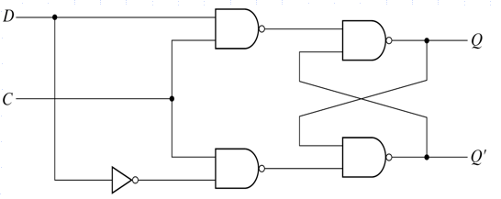
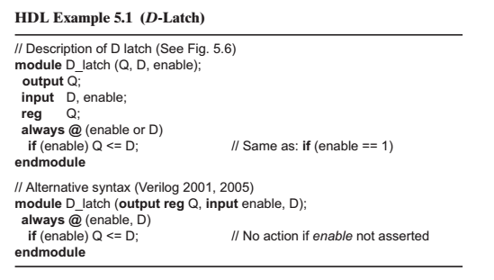
Flip-flops and latches
D- latch
enable = c
c나 d의 값이 바뀌면 밑에 if 문으로 넘어감
*

Slide 3
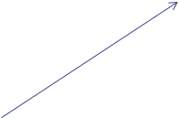
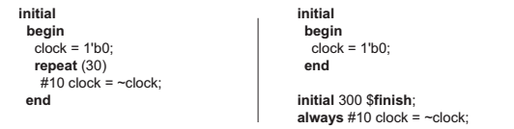


one bit zero
30번 반복
20나노 세컨드를 주기로 15번 반전이 일어나라


Slide 4
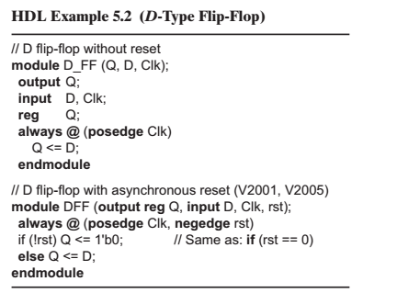


reset이 있는 flip-flop은 reset이 먼저 발현이 돼서 0ㅅㅂ모르겠다 공부하자 flip flop

d값이 q값으로 들어간다


Slide 5
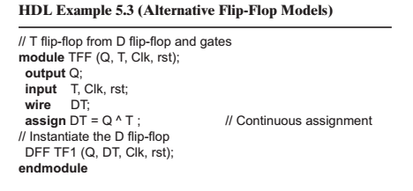
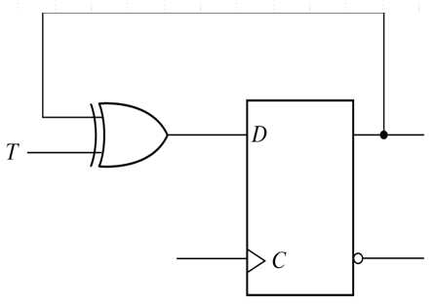
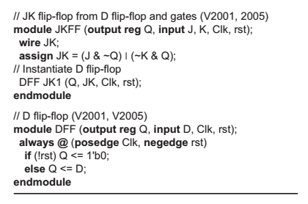
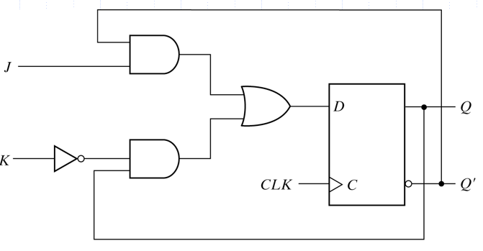
T flip-flop from D flip-flop
q,t,clock,reset
이 그림에는 reset이 안그려져 있음
*

Slide 6
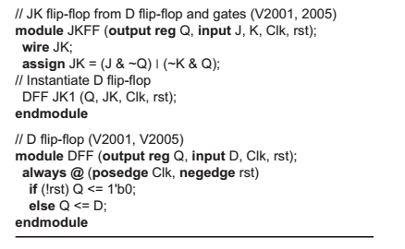
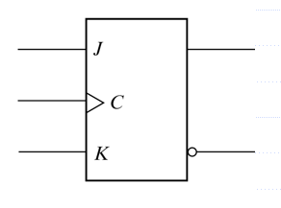
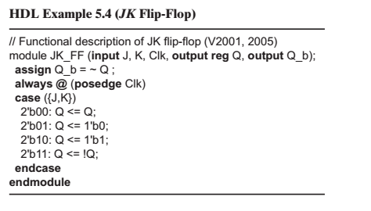
JK flip-flop

Slide 7
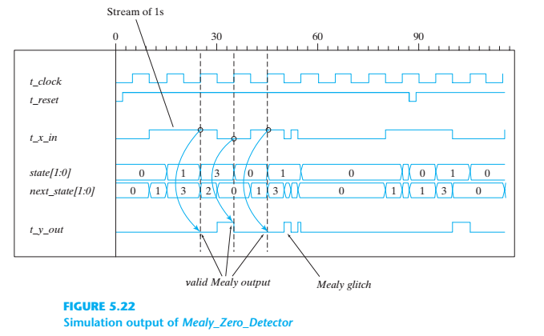
Mealy_zero_Detector simulation output

Slide 8
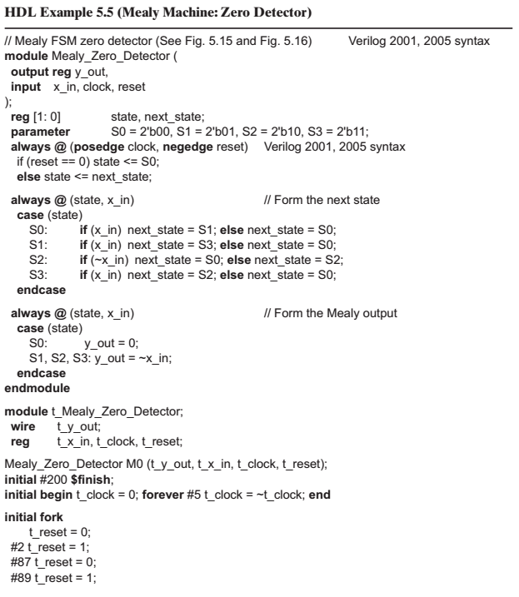
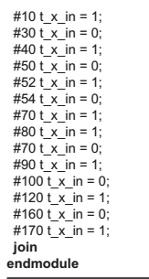
Mealy zero Detector
공부 x
ASIC Lab.
*

Slide 9
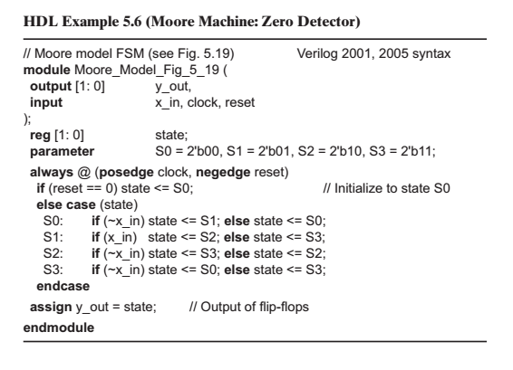
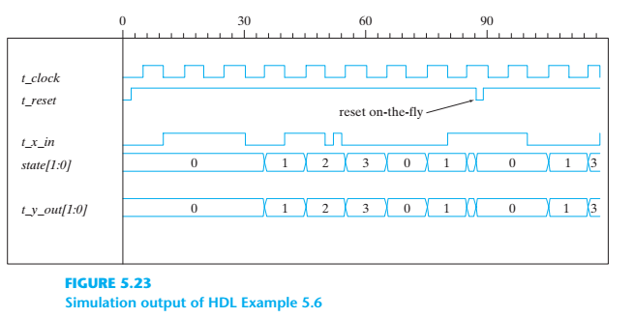
Moore zero Detector

Slide 10
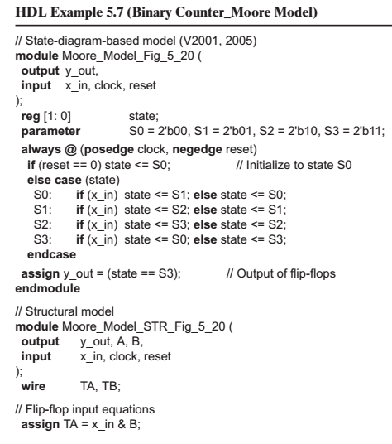
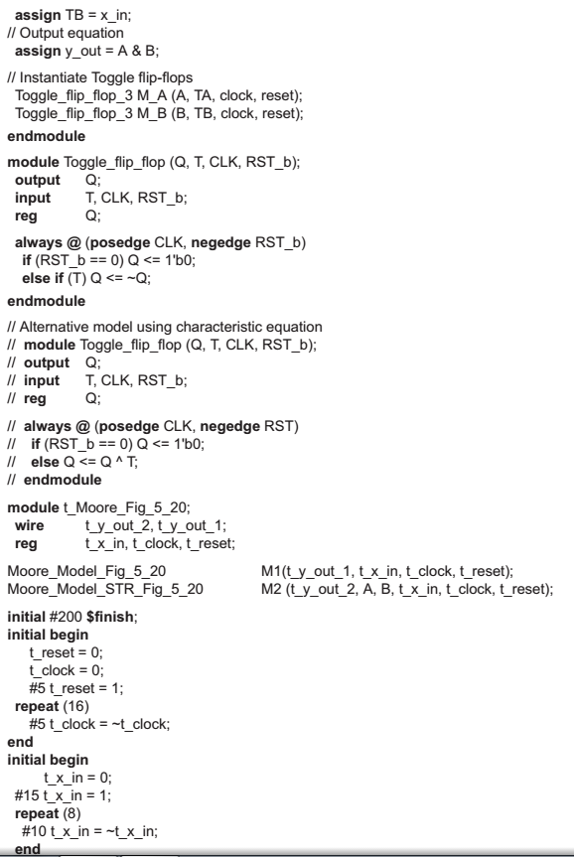
Binary counter Moore model

Slide 11
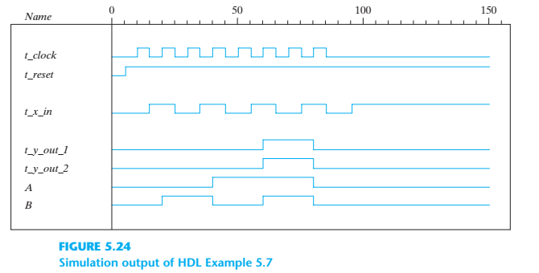
Simulation output of ex 5.7

Slide 12
5.7 State reduction and assignment
State reduction is used to reduce the number of flip-flops in a sequential circuit-> 회로 간단하게 하자
Only input/output sequences are important
Interested in present states that go to the same next state and have the same output
- m flip-flops → 2^{m} states: a reduction in the number of states
may (or may not) result in a reduction in the number of flip-flops
- Unpredictable effect: reduction in the number of flip-flops is
that sometimes the equivalent circuit (with fewer flip-flops)
may require more combinational gates
ASIC Lab.
*

Slide 13
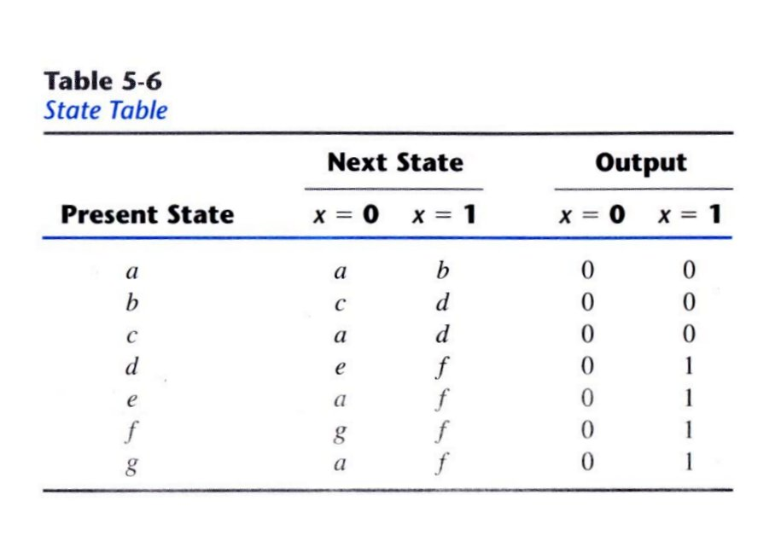
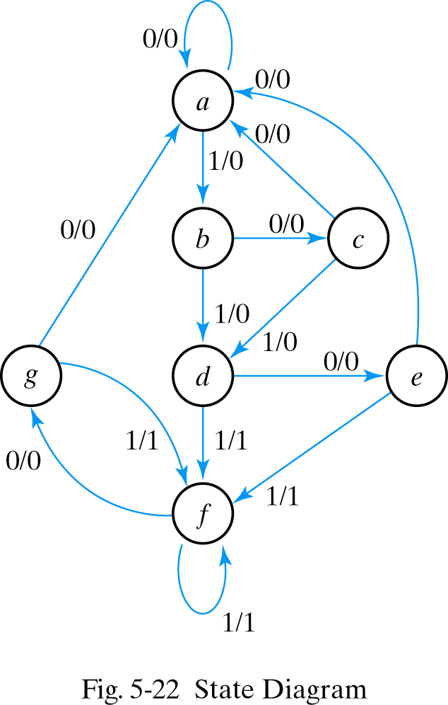
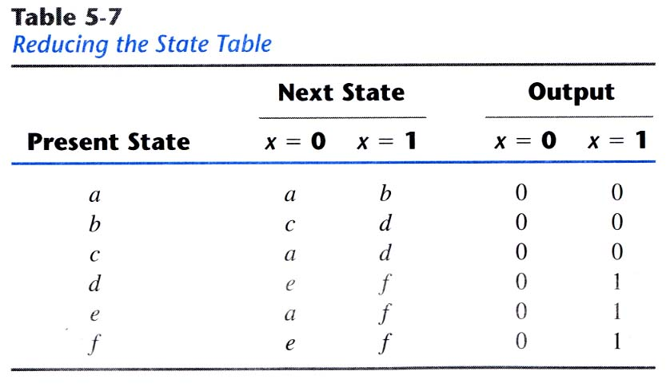
State reduction
State a a b c d e f f g f g a
Input 0 1 0 1 0 1 1 0 1 0 0
Output 0 0 0 0 0 1 1 0 1 0 0
Two states are said to be equivalent if, for each member of the set of
inputs, they give exactly the same output and send the circuit either to the
same state or to an equivalent state, without altering the input-output relationships
input
equivalent
equivalent

Slide 14
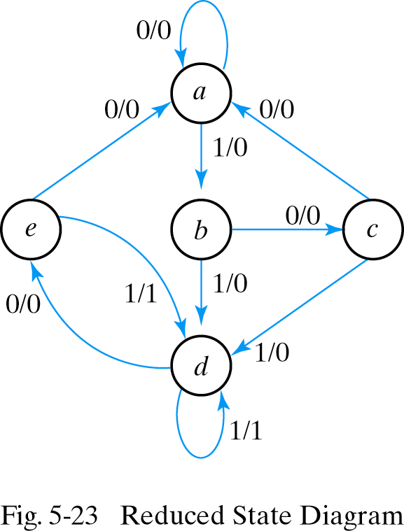
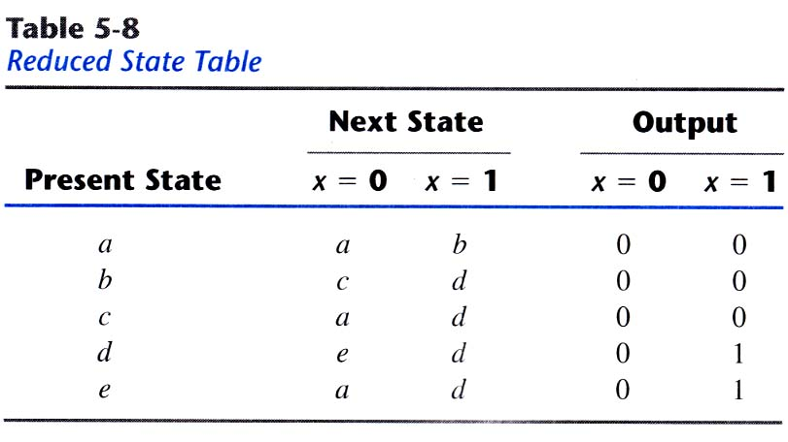
State reduction
State a a b c d e d d e d e a
Input 0 1 0 1 0 1 1 0 1 0 0
Output 0 0 0 0 0 1 1 0 1 0 0

Slide 15
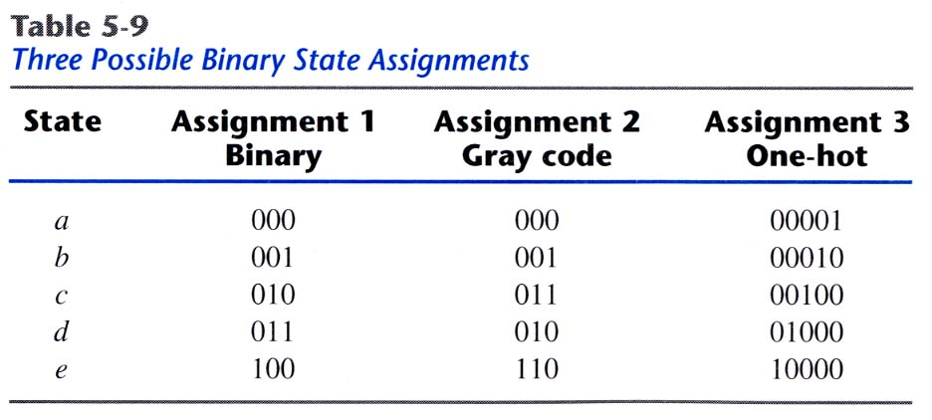
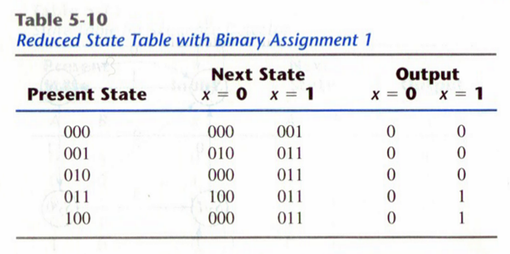
State assignment
m states circuit, codes must contain n bits where 2ⁿ ≥m (cf. 3 bits → 8 codes)
Three possible binary state assignments
5 states
3: unused
(don’t care
→ Help in obtaining a simpler circuit)
At any given time,
only one bit is equal
to 1 while all others
are kept at 0
One flip-flop
per state

Slide 16
5.8 Design procedure
Sequential circuit design : requires state table
⇔ Combinational circuit : truth table
The number of flip-flop is determined from the number of states in circuit
  If 2ⁿ states exist, there are n flip-flops
Design procedure
Designer use intuition and experience
to arrive at the correct interpretation
of the circuit spec.
Design steps
  1) From the word description and specifications of the desired operation, derive a state diagram or state table
  2) Reduce the number of states if necessary
  3) Assign binary code to the state
  4) Obtain the binary-coded state table
  5) Choose the type of flip-flops to be used
  6) Derive the flip-flop input equations and output equations
  7) Draw the logic diagram
synthesis
ASIC Lab.
*

Slide 17
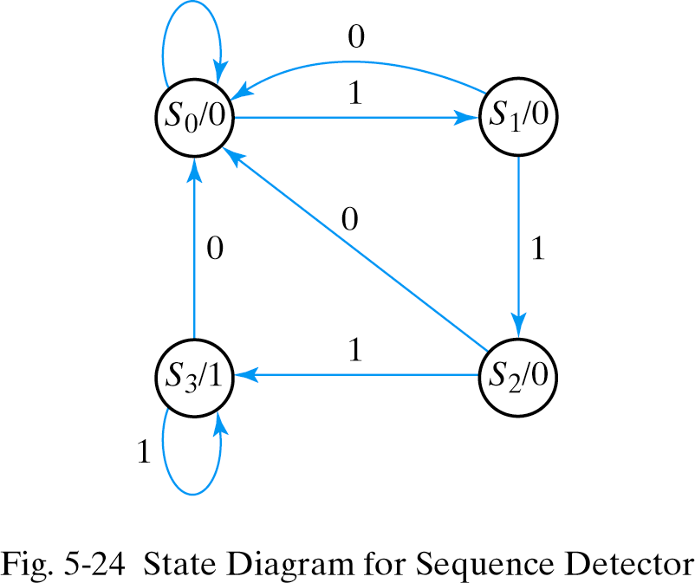
Derive a state diagram
Sequential detector
  Three or more consecutive 1’s in a string of bits coming through an input line
0

Slide 18
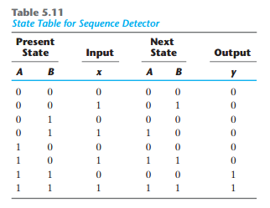
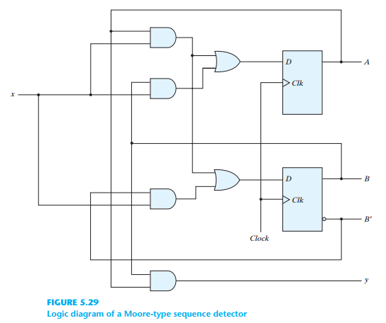
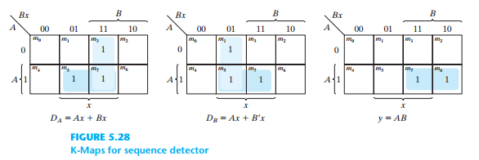
Synthesis using D flip-flops
Input equations are obtained directly from the next states
A(t+1)= D_{A}(A,B,x)= ∑(3,5,7)
B(t+1)= D_{B}(A,B,x)= ∑(1,5,7)
y(A,B,x)= ∑(6,7)
K-maps and logic diagram
D_{A}= Ax+Bx
D_{B}= Ax+B´x
y=AB

Slide 19
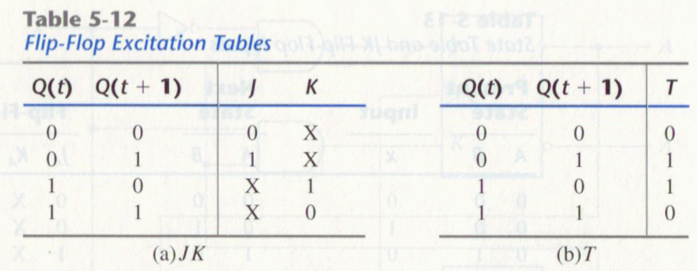
Excitation tables
During the design process we usually know the transition from present
state to next state and wish to find the flip-flop input conditions that
will cause the required transition → the required inputs for a given
change of state: Excitation table

Slide 20
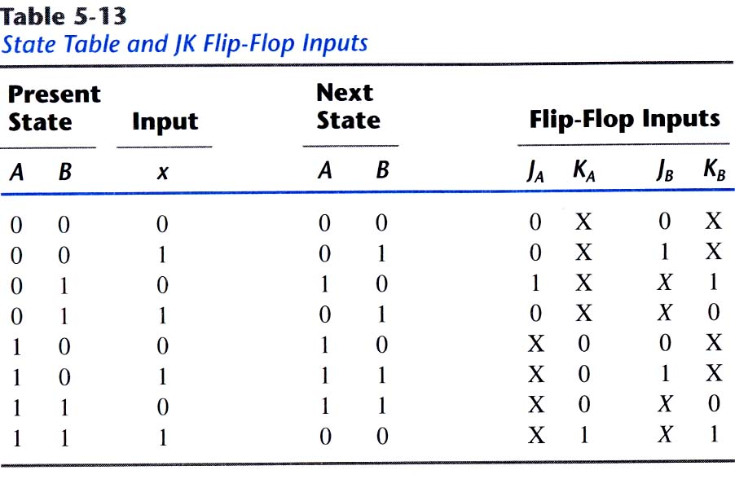
Synthesis with JK flip-flops
Input equations evaluated from the present state to next state transition
ASIC Lab.
*

Slide 21
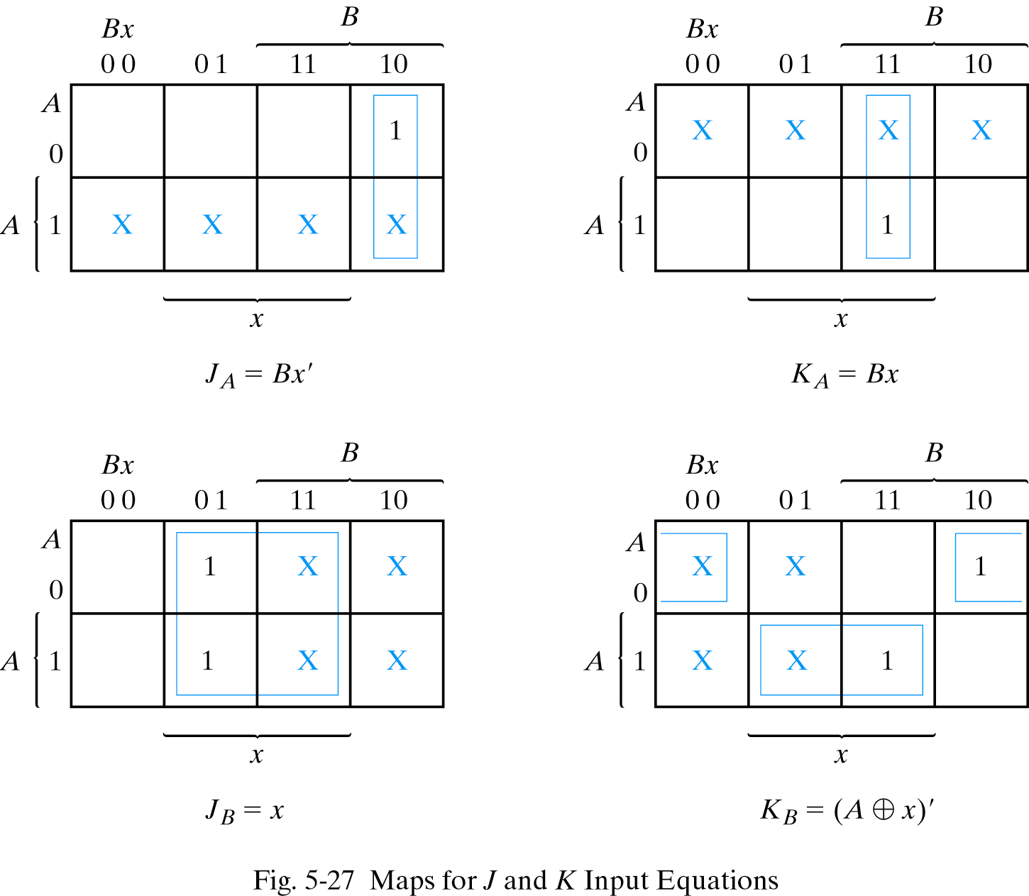
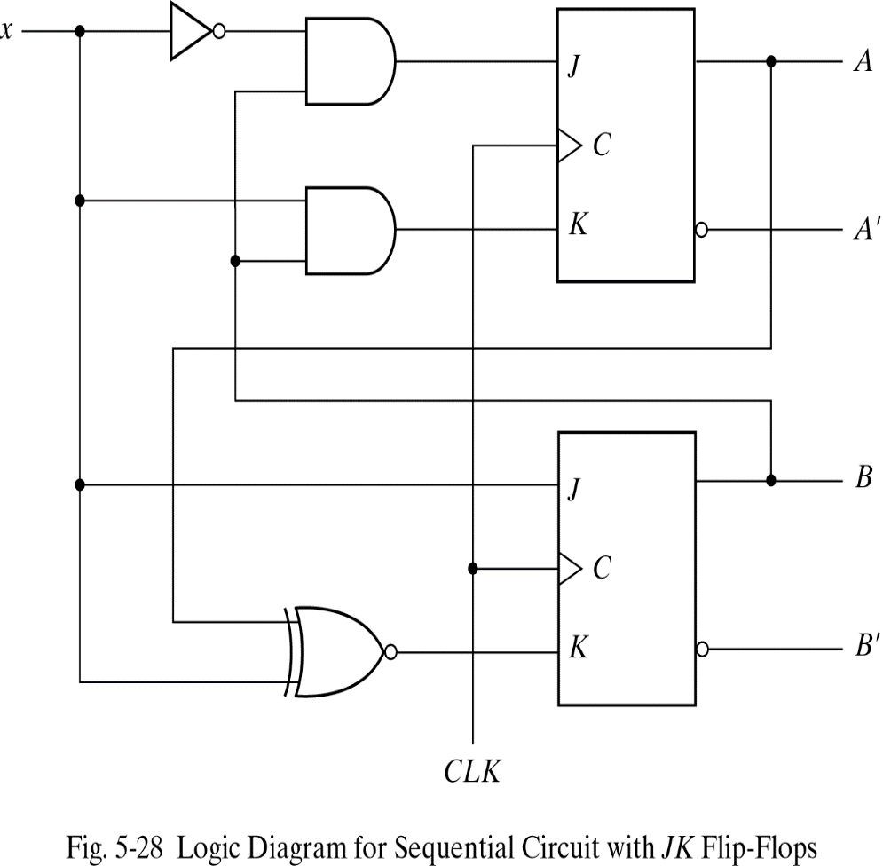
Synthesis using JK flip-flops
K-maps and logic diagram

Slide 22
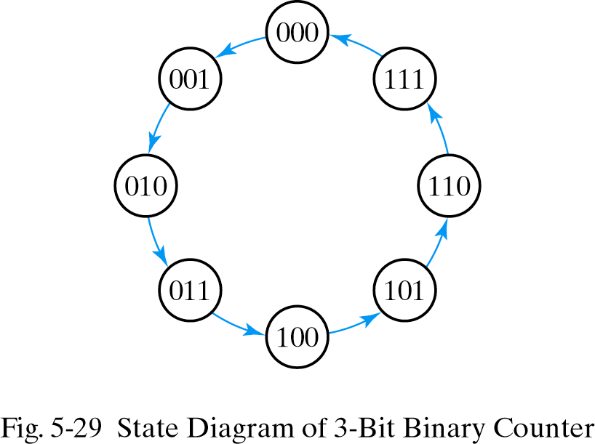
Synthesis using T flip-flops
3-bit binary counter
  3-bit counter has 3 flip-flops and can count from 0 to 2ⁿ-1(n=3)
The clock does not appear explicitly
as an input variable in as state diagram
or state table
→The state diagram of a counter does
not have to show input and output values
along the directed lines
ASIC Lab.
*

Slide 23
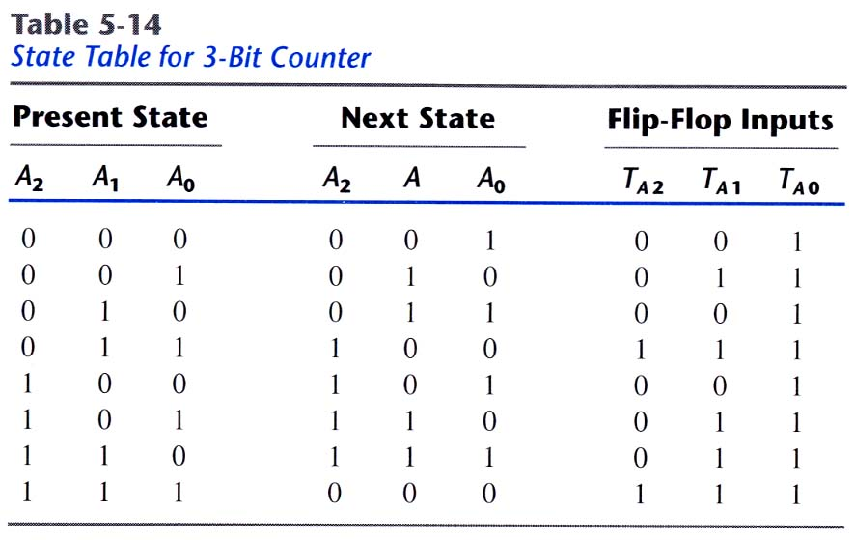
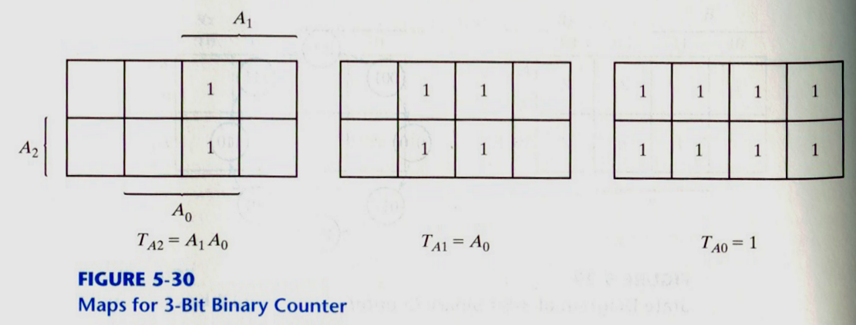
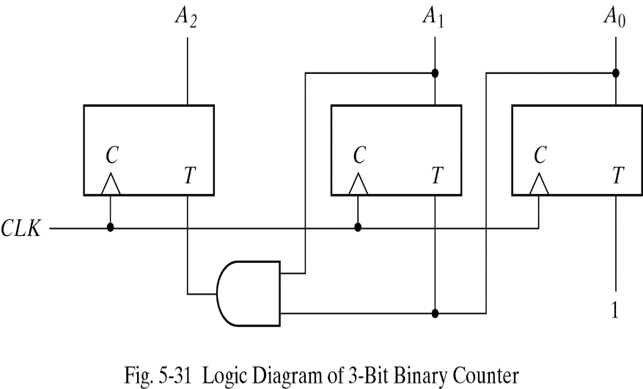
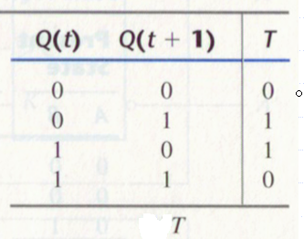
Synthesis using T flip-flops
State table and logic diagram
1

